Slide 1


TGH offers reliable integration solutions, streamline business ecosystem, implement automation thus delivering efficient, effective and emerging digital solution with revenue growth.
www.techygeekhub.com

Slide 2

VARIABLE AND LISTS IN WORAKTO

Slide 3

Topics to Cover:-
1: What is Variable in workato ?
2: How to create and update a variable in workato .
3: What is lists in workato ?
4: How to create a list?
5. How to add & clear items in a list .
6. Use of variable and lists .

Slide 4
What is a variable ?
Variable = Workato variable is a user-declared datapill that contains a data value. These user-declared variables are different from a standard datapill in that your declared variables are mutable - the value of the variable can be changed within a recipe.
Lifetime or Scope = Cloud systems are applications that run on the internet instead of your company’s local servers. These applications are hosted, maintained, updated, and secured by the SaaS provider such as Salesforce, Workday, ServiceNow, SAP Cloud, etc.

Slide 5
Workato On-Prem Agent
A lightweight Java-based application installed inside your on-prem network (data center/VPN/local server).
Acts as the bridge between Workato Cloud and your internal systems.
All communication happens securely and automatically through the agent.
No need to expose your internal servers to the internet.
No inbound ports need to be opened in your firewall.

Slide 6
Secure Connection Architecture
The On-Prem Agent creates outbound-only HTTPS connections to Workato Cloud.
Uses mutual TLS (mTLS), where both Workato Cloud and the agent verify each other using certificates.
No external system directly accesses your on-prem servers.
All messages between cloud and on-prem flow through secure encrypted tunnels created by the agent.
This design ensures that your internal systems stay isolated and safe.

Slide 7
Why Outbound-Only
Major Security Benefits
Your firewall remains closed to the outside world.
No public IP or external access is required for internal resources.
All activity is triggered from inside your network → safe from external attacks.
Reduces risks such as:
  Port scanning
  Unauthorized connections
  DDOS attacks
  Exploits and malware
Ensures industry-standard security compliance.

Slide 8
Use Case - Receiving Emails
Scenario: Automatically fetch invoices from mailbox
Flow: Mail Connector (Get) → Mapping and Storage

Slide 9
MAIL V/S IMAP:-
Feature | Mail Connector | IMAP (with SMTP)
Email Sending | Can send emails directly | Needs SMTP alongside IMAP to send
CC/BCC Support | Limited or no support for CC/BCC | Supported when using SMTP with proper setup
Reading Emails | Not designed for reading inbox | Designed to read emails from server
Sending Attachments | Attachments can be added and sent | Possible with SMTP, but not via IMAP alone
Reading Attachments | Usually not supported | Fully supported (downloadable from server)

Slide 10
Challenges and Tips
Common issues: wrong port, authentication errors
Best practices:
  - Use environment extensions
  - Test with dummy mailboxes
  - Validate filters

Slide 11
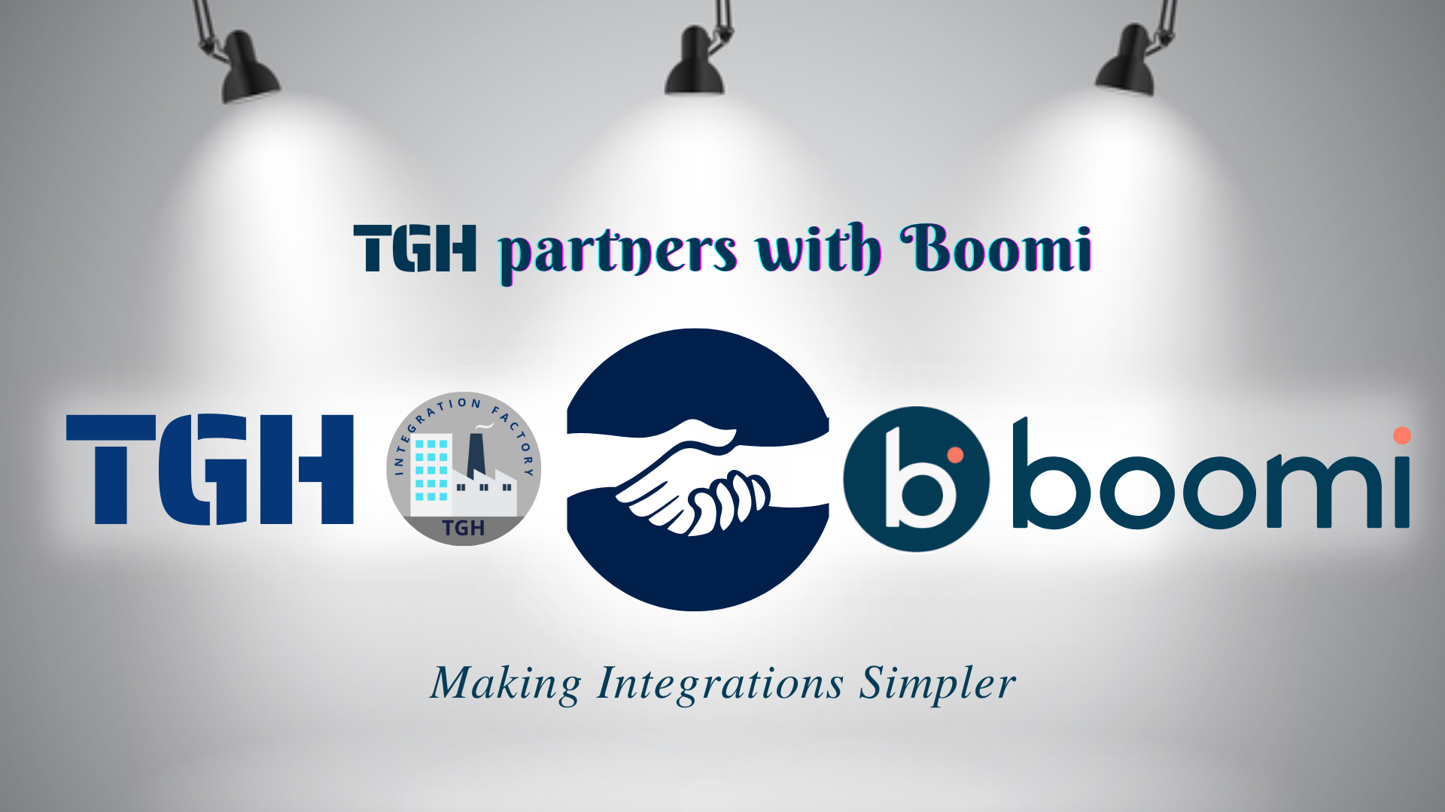

Slide 12


